Slide 1
The C.I.A Model
A stress management technique for helping to put things into perspective and re-establishing a sense of control.

Slide 2
The Power of Choice
Dr Vitkor Frankl, author of the book “Man’s Search for Meaning” was imprisoned by the Nazis in WWII because he was a Jew. His wife, his children, and his parents were all killed in the holocaust.
The Gestapo made him strip. He stood there totally naked. As they cut away his wedding band, Viktor said to himself,
“You can take my wife, you can take away my children, you can strip me of my clothes and my freedom, but there is one thing no person can ever take away from me – and that is my freedom to choose how I will respond to what happens to me!”
The last of the human freedom – to choose one’s attitude in any given set of circumstances, to choose one’s own way.

Slide 3
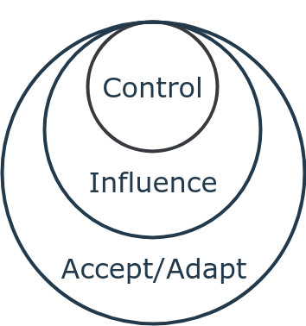
C-I-A
A stress-management tool that identifies three ways to respond to challenges:
Control: identify the issues or elements of a situation that you can control.
Influence: identify the elements that you can't control, but that you can influence.
Accept: identify the things that you can neither control nor influence, and adapt accordingly.
When you understand these potential responses, you can put problems into perspective more easily and get a sense of what you can and can't accomplish. This enables you to focus your efforts where they'll have the most impact.

Slide 4
C-I-A
Consider a situation or decision in life and ask yourself: Is this a C, an I, or an A?
Is this a situation or decision over which I have direct control? (This is limited to our awareness about ourselves and the actions we take. The key to control lies in the choices we make about how to manage ourselves in three domains – language, emotion and body.)
If I don’t have direct control, can I influence the decision, approach, or outcome? And how can I most effectively exert that influence?
If I have neither control nor influence, can I accept the reality of the situation? What can I do to make it more palatable? And if I can’t accept or adapt...what then?

Slide 5
What can we control or influence about our life situation and what must we accept?
Control | Influence | Accept

Slide 6
Serenity Prayer
Grant me the serenity to accept the things I cannot change, courage to change the things I can, and the wisdom to know the difference.

