Slide 1
Connectedness

Slide 2
CHIME
The CHIME framework for personal recovery
Connectedness
Peer support and social groups
Support from others
Hope & optimism
Belief in recovery
Identity
Meaning
Relationships
Community
Motivation to change
Hope-inspiring relationships
Positive thinking and valuing effort
Having dreams and aspirations
Rebuilding positive sense of identity
Overcoming stigma
Empowerment
Meaning in mental health experience
Meaningful life and social roles
Meaningful life and social goals
Personal responsibility
Control over life
Focusing upon strengths
Leamy et al. 2011

Slide 3
“Connection is why we are here. We are hardwired to connect with others.”
Brene Brown

Slide 4
Recovery from what…?
Loss of valued roles
Loss of connectedness
Loss of self
Loss of power
Loss of hope

Slide 5
Connectedness in a recovery context
Being connected is associated with good mental health and wellbeing.
For most people, we thrive in social groups. Our connection with other people – and theirs with us – makes us stronger.
The support we get and give makes us more resilient when bad times come along, and that needs to be nurtured.

Slide 6
Lost Connections
https://www.youtube.com/watch?v=bC2Na1E3iVg

Slide 7
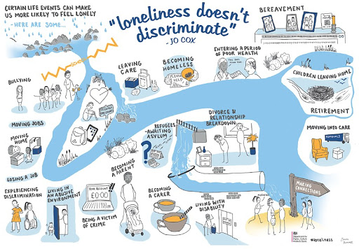

Slide 8
Social isolation
The inadequate quality and quantity of social relations with other people at the different levels where human interaction takes place (individual, group, community and the larger social environment).
Loneliness
An emotional perception that can be experienced by individuals regardless of the breadth of their social networks.

Slide 9
Social Recovery
Social recovery is perceived as a key dimension of mental health recovery, albeit a relatively neglected one.
What is the place of social recovery in mental health alongside personal recovery?

Slide 10
Connectedness

Slide 11
Connectedness
We are both social and independent beings.
We all need time apart. Periods of solitude can allow us to reflect on experiences and explore our creativity. But staying within reach is important.
That said, feeling comfortable on our own probably directly relates to knowing we can easily reconnect with others.
Hence, the goal in life is to maintain an interdependent existence i.e. grow up to become BOTH independent individuals AND people who can create and maintain relationships.

Slide 12
Identifying your networks of support
Consider the following questions:
How connected are you?
What do you do to get connected to people?
Who listens to you when you need someone to talk to?
With whom do you share good or bad news?
When you need advice, who do you go to?
When you have a problem, who do you turn to?

Slide 13
Mapping out your networks of support
Mapping your networks of support can be a good way to health-check your support system, and to take responsibility for making sure it’s robust.
People tend to find that they cope better with situations when they have a support system in place.

Slide 14
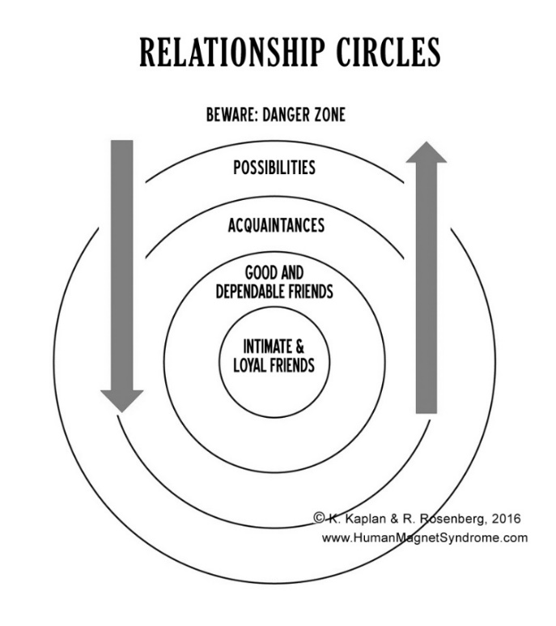
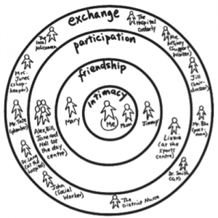
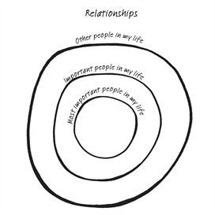
Mapping Networks of Support

Slide 15
NETWORKS OF SUPPORT
FAMILY & FRIENDS
SERVICES/COMMUNITY GROUPS

Slide 16
Networks of Support
Consider your networks of support:
What does your diagram tell you about your ability to ask for and receive support when you need it?
Are you leaning too heavily on members of your support network or on a particular service?
Do you have sufficient supports in place, or do you need to expand your network?
What specific steps could you take to expand your support network?

Slide 17
Beliefs sentence completion exercise
In life, behaviour follows belief. Everything we do is directly connected to what we believe is true. Complete the following sentence stems.
Do you believe you are a person of worth, deserving of connection?
I am…
Other people are…
The world is…
Does your belief take you closer towards or further away from people?

Slide 18
