Slide 1
Meaning

Slide 2
“Life is never made unbearable by circumstances but only by lack of meaning and purpose.”
Viktor Frankl
Notes:
“The end of history illusion” - at any point along our personal journey, we tend to believe that who we are at that moment is the final destination of our becoming. Which, of course, is not only wrong but a source of much of our unhappiness.

Slide 3
CHIME
The CHIME framework for personal recovery
Connectedness
Peer support and social groups
Support from others
Hope & optimism
Belief in recovery
Identity
Meaning
Relationships
Community
Motivation to change
Hope-inspiring relationships
Positive thinking and valuing effort
Having dreams and aspirations
Rebuilding positive sense of identity
Overcoming stigma
Empowerment
Meaning in mental health experience
Meaningful life and social roles
Meaningful life and social goals
Personal responsibility
Control over life
Focusing upon strengths
Leamy et al. 2011

Slide 4
Meaning in a recovery context
A large part of recovery is learning to make sense of what has happened to us as well as improving our wellbeing on a daily basis.
Meaning is the sense we make of our lives.
Happiness comes and goes. Meaning gives you something to hold onto.
When you have found purpose in your life, the idea of becoming lost again will seem impossible, and that is because it will be.

Slide 5
Questions for meaning making
We all find meaning in very different ways.
Consider the following questions:
What’s most important to you in your life?
Why do you care about these things?
Do you have any long-term goals?
Why are these goals important to you?
What does it mean to have a good life?
What does it mean to be a good person?
If I were looking back on your life, how would you want to be remembered?

Slide 6
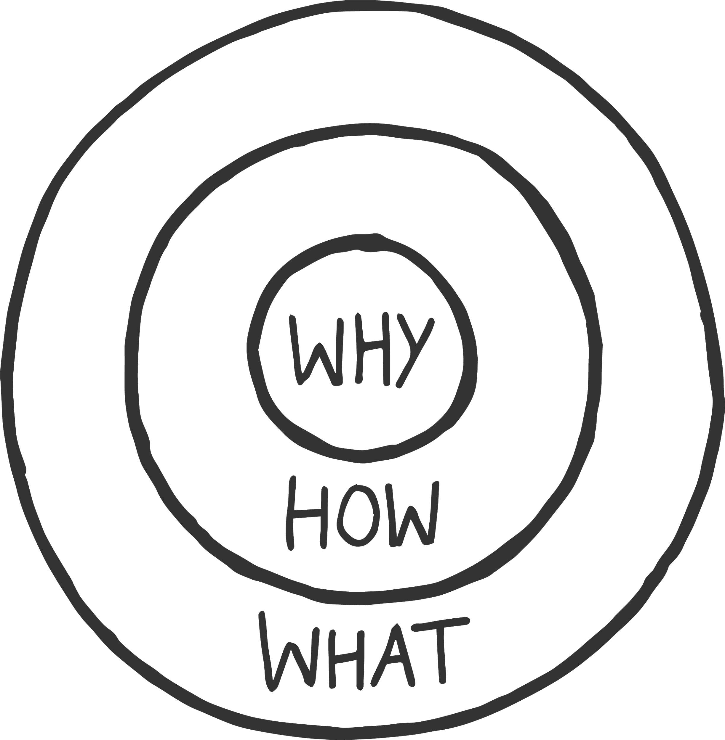
What is your why?
Your why will keep you going on days you don’t want to.
List as many reasons as possible, why you want to recover/get better.
When your why is big enough you will find your how.

Slide 7
“If you don’t design your own life plan, chances are you’ll fall into someone else’s plan. And guess what they have planned for you? Not much.”
Jim Rohn

Slide 8
How? Create a life plan
Having a life plan means working towards clarifying your values (i.e. what matters to you), beliefs and priorities, and then applying them in your daily life.
What is significant about a life plan is that it can help you live your own life (i.e. take control).
Achieving a satisfying life requires knowledge, self-awareness, motivation and effort. It involves behaviours that promote wellbeing.

Slide 9
“The purpose of life is a life of purpose.”
Robert Burns

Slide 10
Why does purpose matter?
Having a purpose is good for both you and the world. It drives you to make positive contributions in line with your own interests and strengths. And this pursuit gives your life direction and forward momentum; it motivates and guides your short-term goals and daily activities.
With a strong sense of purpose, you flourish: you enjoy a more meaningful life, are healthier and more resilient to setbacks, live more energetically, and feel good about what you’ve accomplished.

Slide 11
Purpose pulse check
Think about yourself. How many of these things are true?
I look for ways to have positive effects on others’ lives.
I often reflect on my life goals and the kind of person I want to be.
When I plan out my day, I consider how my activities connect to what I want to accomplish with my life.
I often think about what I can offer the world, taking into account what the world needs as well as my personal strengths and interests.
I often think about what matters most to me and why it matters.

Slide 12
