Slide 1

Big I,
Little i exercise
“The self is too complex to be globally rated.”

Slide 2
Big I, Little i exercise
Self-acceptance, ‘the individual fully and unconditionally accepts him or herself whether or not he/she behaves intelligently, correctly, or competently and whether or not other people approve, respect, or love him/her.
Put simply it means, ‘accepting yourself with warts and all.’
The Big I, little i technique was developed by Arnold Lazarus (1977) based on the concept of the egoless state.
The Big “I” represents you, your totality. And the little “i”s, stand for various things about you, such as the way you smile, the kind of TV programmes you like and so on.
The secret of self-acceptance is to stop seeing ourselves as a single entity. We are made up of hundreds of components parts.

Slide 3
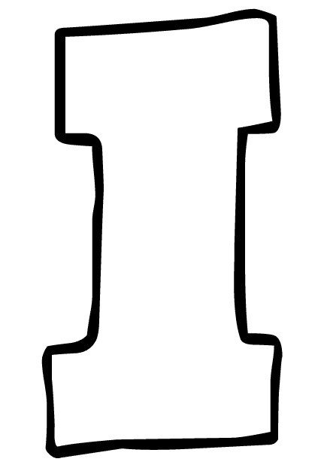

Big I, Little i exercise
This Big ‘I’ represents you in your totality
However, we are made of hundreds of ‘i’s’

Slide 4
Instructions: Fill in this big I with a few things about you.
Big I, Little i exercise
Consider the following questions:
What would your family and friends say were some of your good points?
What negative things would they say about you?
Now, what about any neutral or indifferent things about yourself?

