Slide 1
Self-Care

Slide 2
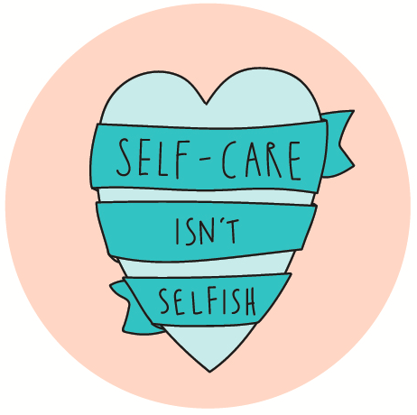

Slide 3
I give myself permission to…
I give myself permission to…
I give myself permission to…
I give myself permission to…
I give myself permission to…
I give myself permission to…
I give myself permission to…

Slide 4
“With every act of self-care your authentic self gets stronger, and the critical fearful mind gets weaker.
Every act of self-care is a powerful declaration: I am on my side, each day I am more and more on my own side.”
Susan Weiss Berry

Slide 5
Self-Care
What does self-care mean to you?

Slide 6
Self-Care - defined
Self-care is any activity that we do deliberately in order to take care of our mental, emotional, physical and spiritual health.
Although it's a simple concept in theory, it's something we very often overlook.

Slide 7
Building a Self-Care Action Plan
Physical
Exercise + Rest
Nutrition
Emotional
Expression
Relationships
Mental
Interest
Flow
Spiritual
Connections
Purpose

Slide 8
Building a Self-Care Action Plan
Physical
Exercise + Rest
Nutrition
The things you do to take care of your body in healthy ways. Examples include: sleep; nutrition; exercise; and health care visits.
How well do you take care of yourself physically? Identify three activities that you currently do and/or plan to engage in from this point forward to take care of yourself physically.
1)
2)
3)

Slide 9
Building a Self-Care Action Plan
Emotional
Expression
Relationships
The things you do to take care of your feelings in healthy ways. Examples include: maintaining support systems; journaling; and talking about feelings in health ways.
How well do you take care of yourself emotionally? Identify three activities that you currently do and/or plan to engage in from this point forward to take care of yourself emotionally.
1)
2)
3)

Slide 10
Building a Self-Care Action Plan
Mental
Interest
Flow
The things you do to take care of your mind and understand yourself better. Examples include: reading for pleasure, writing; and, engaging in continued education for additional knowledge/skill.
How well do you take care of yourself psychologically? Identify three activities that you currently do and/or plan to engage in from this point forward to take care of yourself psychologically.
1)
2)
3)

Slide 11
Building a Self-Care Action Plan
Spiritual
Connection
Purpose
The things you do to gain perspective on life. Examples include: prayer; meditation; contact with nature.
How well do you take care of yourself spiritually? Identify three activities that you currently do and/or plan to engage in from this point forward to take care of yourself spiritually.
1)
2)
3)

Slide 12
Self-Care Maintenance
Barriers to maintaining my self-care strategies: 1) 2) 3) | How I will address these barriers and remind myself to practice self-care: 1) 2) 3)
Negative coping strategies I would like to use less of or not at all: 1) 2) 3) | What I will do instead: 1) 2) 3)

Slide 13
Self-Care tips
Drink a glass of water as soon as you wake up. Eat a balanced diet. Put your needs first. Take five deep breaths. Get a plant - Nurturing a plant has therapeutic benefits. Sit up straight. Pay attention to your posture. Make a meal planner for the week - By pre-planning your meals you can eliminate impulse purchases. Have a mini dance party. Light a smelling candle. Buy fresh flowers. | Move at least 30 minutes a day. Have a digital detox – set a specific time to come off all technology. Take five minutes to decompress at the end of every day. Get plenty of sleep. Cuddle pets. Go outside for fresh air. Drink herbal tea. Walk in nature. Watch the sunset. Listen to your favourite song on repeat. Put on nice clothes.

Slide 14
“Love of others and love of ourselves are not alternatives.”

Slide 15
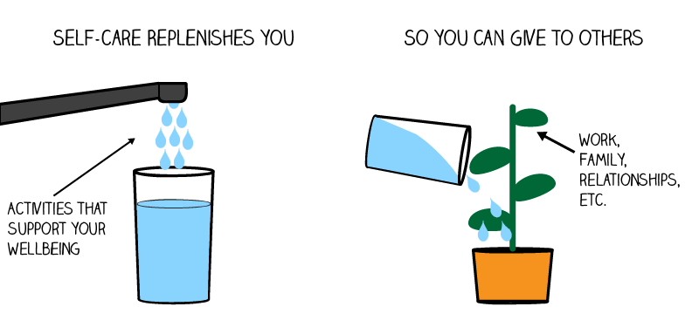

Slide 16
Self-care routine sentence completion activity:
I am going to stop…
During my morning routine, I will practice self-care by…
During my evening routine, I will practice self-care by…
The gesture of self-worth I am going to take towards myself in the next 24 hours is…

Slide 17
“Daring to set boundaries is about having the courage to love ourselves, even when we risk disappointing others.”
Brene Brown

Slide 18
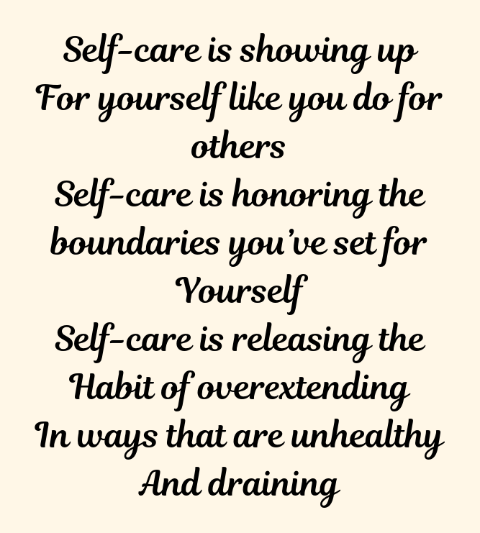
Boundaries
If you are not sure you are good at setting boundaries or indeed have any at all, ask yourself these questions:
How often do I worry about what other people think?
Do I feel guilty for wanting to do things by myself?
When did I last say no to someone?
When did I last say yes to something I secretly didn’t want to do?
Do I feel like I deserve respect or I have to earn it by being ‘nice’?
When I think about saying no to someone, do I feel afraid? Or calm inside?

Slide 19
