Slide 1
Money &
Finance

Slide 2
Financial wellbeing in a recovery context
Money buys pleasure, and it also buys security.
Financial wellbeing is about a sense of security and feeling as though you have enough money to meet your basic needs – to buy food and shelter.
It’s also about being in control of your day-to-day finances and having the financial freedom to make choices that allow you to enjoy life.

Slide 3
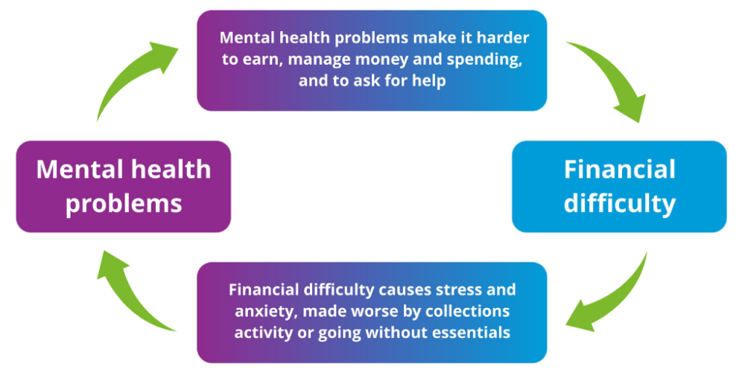
Money and Mental Health
Source: Money and Mental Health Policy Institute. 2019.

Slide 4
Money and Me
Consider the following questions:
What does money mean to you personally? How did this attitude come to form? What were your family’s values about money?
Do you have bad financial habits? (Think about when you spend money and why.)
What is your biggest concern about money?
What are you hopes and dreams about money?

Slide 5
Money sentence completion exercise
For me, having enough money means being independent.
For me, having enough money means avoiding stress.
For me, having enough money means…
For me, having enough money means…
For me, having enough money means…
For me, having enough money means…
For me, having enough money means…
For me, having enough money means…

Slide 6
Budget
A budget is simply a plan for how you will use your money. It can also be called a spending plan.
Comparing and tracking income and outgoings is key to successful budgeting, and can help you make the most of your money.
Give every pound a job to do and if it doesn’t have a job, give it one. For example, putting money into savings, allocating to different bills or personal spending.

Slide 7
Benefits of a budget
Gives a sense of control.
Makes you aware of what is going on with your money.
Helps you organise your spending and saving.
Keeps you focused on goals/priorities.
Enables planning for expected and unexpected costs.
Helps when making wider plans.

Slide 8
50/20/30 Budget Rule
Senator Elizabeth Warren popularised the so-called "50/20/30 budget rule" in her book, All Your Worth: The Ultimate Lifetime Money Plan.
The rule states that you should spend up to 50% of your after-tax income on needs and obligations that you must-have or must-do.
The remaining half should be split up between 20% savings and debt repayment and 30% to everything else that you might want.
50%: Needs are those bills that you absolutely must pay and are the things necessary for survival. E.g. rent or mortgage payments, food shopping and utilities etc.
20%: Savings and also debt repayments.
30%: Wants are all the things you spend money on that are not absolutely essential. This includes eating out, gym memberships, vacations, the latest electronic gadget, and a subscription to Netflix etc.

Slide 9
5:2 Financial Diet
Save for 5 days, spend for 2 days.
If you plan well, you can do your shopping for essentials once a week, and ration your consumption over the week. This can be for food, general shopping and socialising.
Spending a few days a week not spending any money is great practice of discipline to help you save and invest. Much like food and alcohol, small regular consumption often leads to larger addictions.
See spending money as a reward not a daily action.

Slide 10
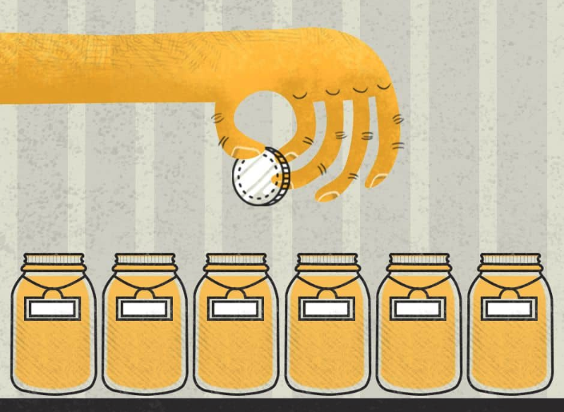
Jam Jar Approach
Jam-jar accounts are specially designed to let you divide your money into different 'jars' within a single account. When money comes into your account, an agreed amount is set aside for essential bills - it is a great way of making sure your bills are covered and your money goes exactly where you want it to.
When you need to spend, you take the money out of the relevant pot.
Keep an eye on the different pots to make sure your budget matches what you’re actually spending. Try to stick to a rule of ‘when it’s gone, it’s gone’

Slide 11
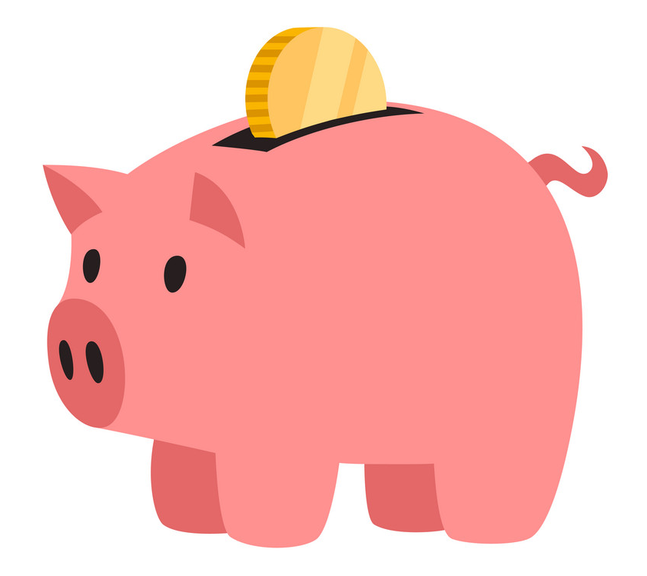
Financial goals
Identify your short and long-term financial goals and create a realistic plan to reach them.
Financial goals maybe:
a holiday
course fees
new car
paying off credit card debts

Slide 12
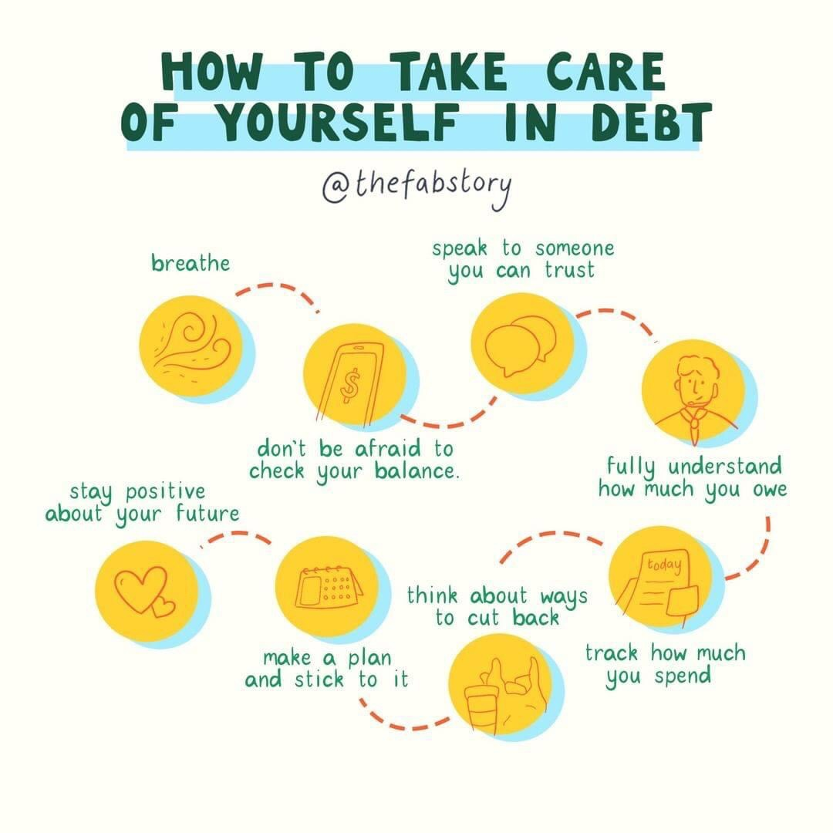

Slide 13
Tops Tips
Make a personal budget.
Keep a money journal - it can help you see clearly when you lose motivation to control your finances or when you might spend more money than normal to make you feel better.
Set yourself a regular time, maybe once a week or month to look at your bills and bank balance.
Don't go to the supermarket without a shopping list. Otherwise, you're buying food you want, not food you need.
Learn to cook and repair things.
Avoid impulse buys. For an item you “must have,” wait 24 hours before buying it. You may find that you don’t really have to have it after all.
Set yourself ‘opening times’ for online shops.
Consider seeking professional advice.

Slide 14
