Slide 1
Peer Support

Slide 2
Connectedness
Think about a time when you…
were included in a community or group. How did it make you feel?
were excluded from a community or group. How did it make you feel?

Slide 3
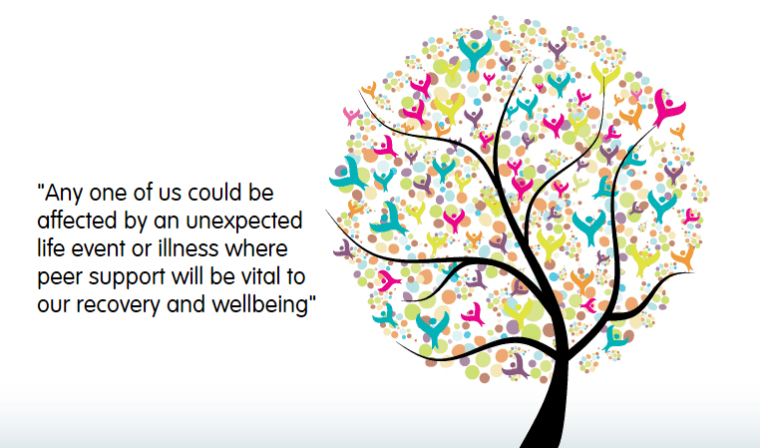

Slide 4
Peer Support pie chart
Divide this pie into pieces to represent what peer support means to you.

Slide 5
Peer Support in a recovery context
Recovery focuses on people recovering a quality of life in their community while striving to achieve their full potential.
Peer support is rooted in the knowledge that “hope is the starting point from which a journey of recovery must begin.”
Peer support can help to increase feelings of belonging and reduce isolation.
Meeting and talking with people with shared experiences helps to identify tips and strategies for managing our mental health, encouraging participants to focus on their strengths and draw on their own experience to help others.

Slide 6
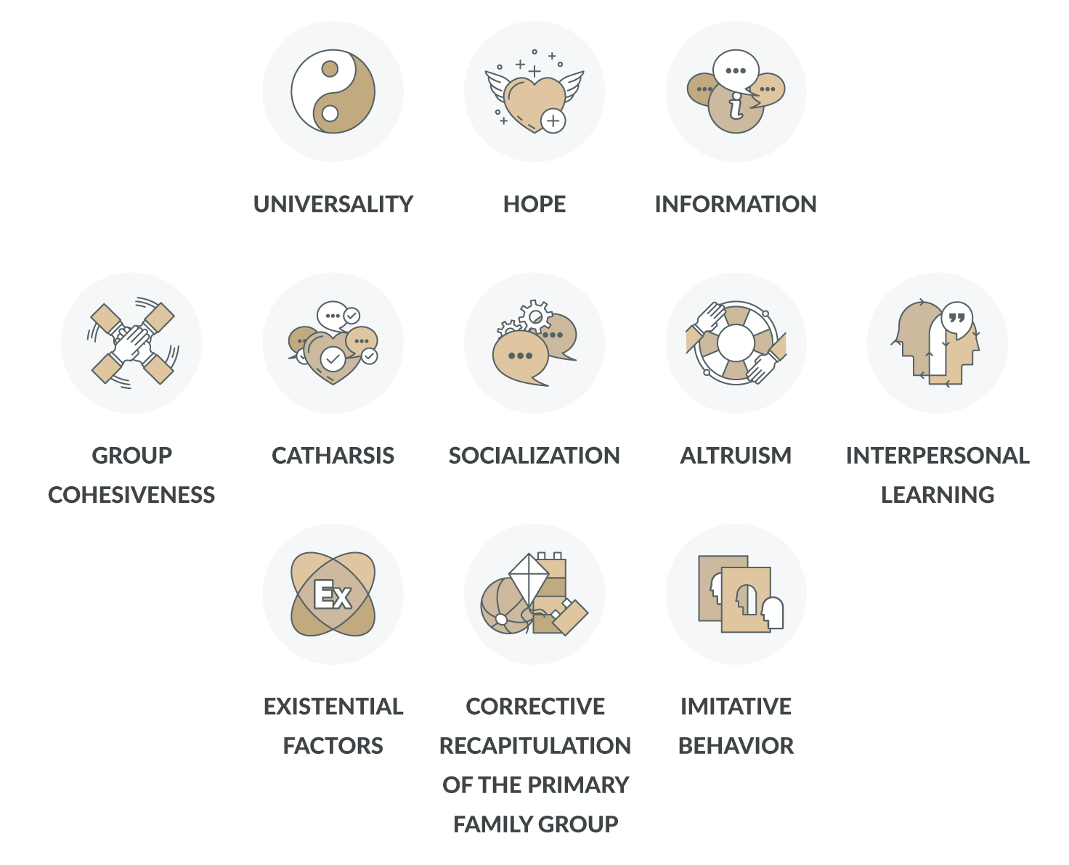
Features of peer support
(Yalom)

Slide 7
Features of peer support
Factors | Definition
Universality | Feelings of having problems similar to others, not alone. Validates experiences.
Instillation of Hope | Members at different stages of development or recovery. Shows that recovery is possible.
Imparting Information | Guidance or advice provided by group members.
Group Cohesiveness | Feelings of trust, acceptance and belonging within the group.
Catharsis | Opportunity to tell your story/for expression/release strong feelings.
Socialisation | Developing social skills – learning new ways to talk about feelings, observations and concerns.
Altruism | Opportunity to rise out of oneself and help somebody else, the feeling of usefulness.
Interpersonal Learning | Receiving feedback from others and experimenting with new ways of relating.
Existential Factors | Recognition of the basic features of existence through sharing with others.
Corrective recapitulation of the primary family group | Gain understanding of the impact of upbringing on personality and patterns of relating.
Imitative Behaviour | Observing and imitating others. Modelling good behaviours.

Slide 9
Benefits of peer support
Meeting with people who speak your language
Learning from people who have been where you are
Sharing your experiences with others
Learning about yourself
No judgement
Boosting self-esteem/self-worth
Social skills
Hope and support
Sense of humour
Cooperation
Helping yourself by helping others

Slide 10
Belonging
Belonging is a natural human need.
It relies on both conformity and individuality.
Through belonging we develop new understandings of ourselves and the world around us.
Our sense of identity is stronger when we belong.

Slide 11
Belonging
Consider the following questions:
What does it mean to belong?
What is community?
In what communities do you have membership?

Slide 12
Belonging vs Fitting in
A bit about “Connection” and “Belonging” from Brene Brown’s book The Gift of
Imperfection. One of the major themes in Brene’s work revolves around the difference between “Belonging” versus “Fitting In”. Often mistaken as synonyms, these two terms have very different meanings, as well as very different impacts on your life.
Fitting in is about assessing a situation and becoming who you need to be to be accepted. For example, think of a chameleon.
Belonging, on the other hand, doesn’t require us to CHANGE who we are. It requires us to BE who we are. Belonging is the innate human desire to have close, caring and intimate relationships with other people and to be part of something larger than us.
Because this yearning is so primal, we often try to acquire it by fitting in and by seeking approval. These strategies are not only hollow substitutes for belonging, but often barriers to it. Because true belonging only happens when we present our authentic, imperfect selves to the world, our sense of belonging can never be greater than our own level of self-acceptance; imperfections, flaws and all.

Slide 13
The 5 A’s
Attention
Acceptance
Appreciation
Affection
Allowing

Slide 14
The 5 A’s
Attention from others leads to self-respect. Acceptance engenders a sense of being inherently a good person. Appreciation generates a sense of self-worth. Affection makes us feel lovable. Allowing gives us the freedom to pursue our own deepest needs, values, and wishes.

Slide 15
Lived Experience
Consider the following questions:
What have you learned about yourself and your recovery that could inspire others working on their recovery if you share the information?
What types of support have you developed and used?
How could you communicate your recovery story to others?

Slide 16
