Slide 1
Music

Slide 2
“Music acts like a magic key, to which the most tightly closed heart opens.”
– Maria Von Trapp

Slide 3
Background
Music can play a big part in our lives. Music can help us to identify and express emotions. Music can help us feel alive and connected. And sometimes music can be life changing.
Listening to music doesn’t have to be the only way music can help. Try singing, playing an instrument, or writing your own music or song.

Slide 4
Music and Wellbeing
Music can sometimes:
express how we are feeling.
relate to our own experiences and emotions.
vent difficult thoughts and emotions.
comfort.

Slide 5
What does music do to you?
Thinking about the music in your life. Consider the following questions:
Does the music allow you to sit with a mood, change a mood or set a new mood?
Does it make you feel better or worse?
Is it helpful to feel worse? When does it stop being helpful? For example, rather than music having a calming effect on you, listening to it might make you feel more angry or anxious.
Is it a certain style of music that is helpful or unhelpful or is it a certain artist or words in a song?
Once we are aware of how music affects us, we can then start to be more conscious about what and when we listen to music.

Slide 6
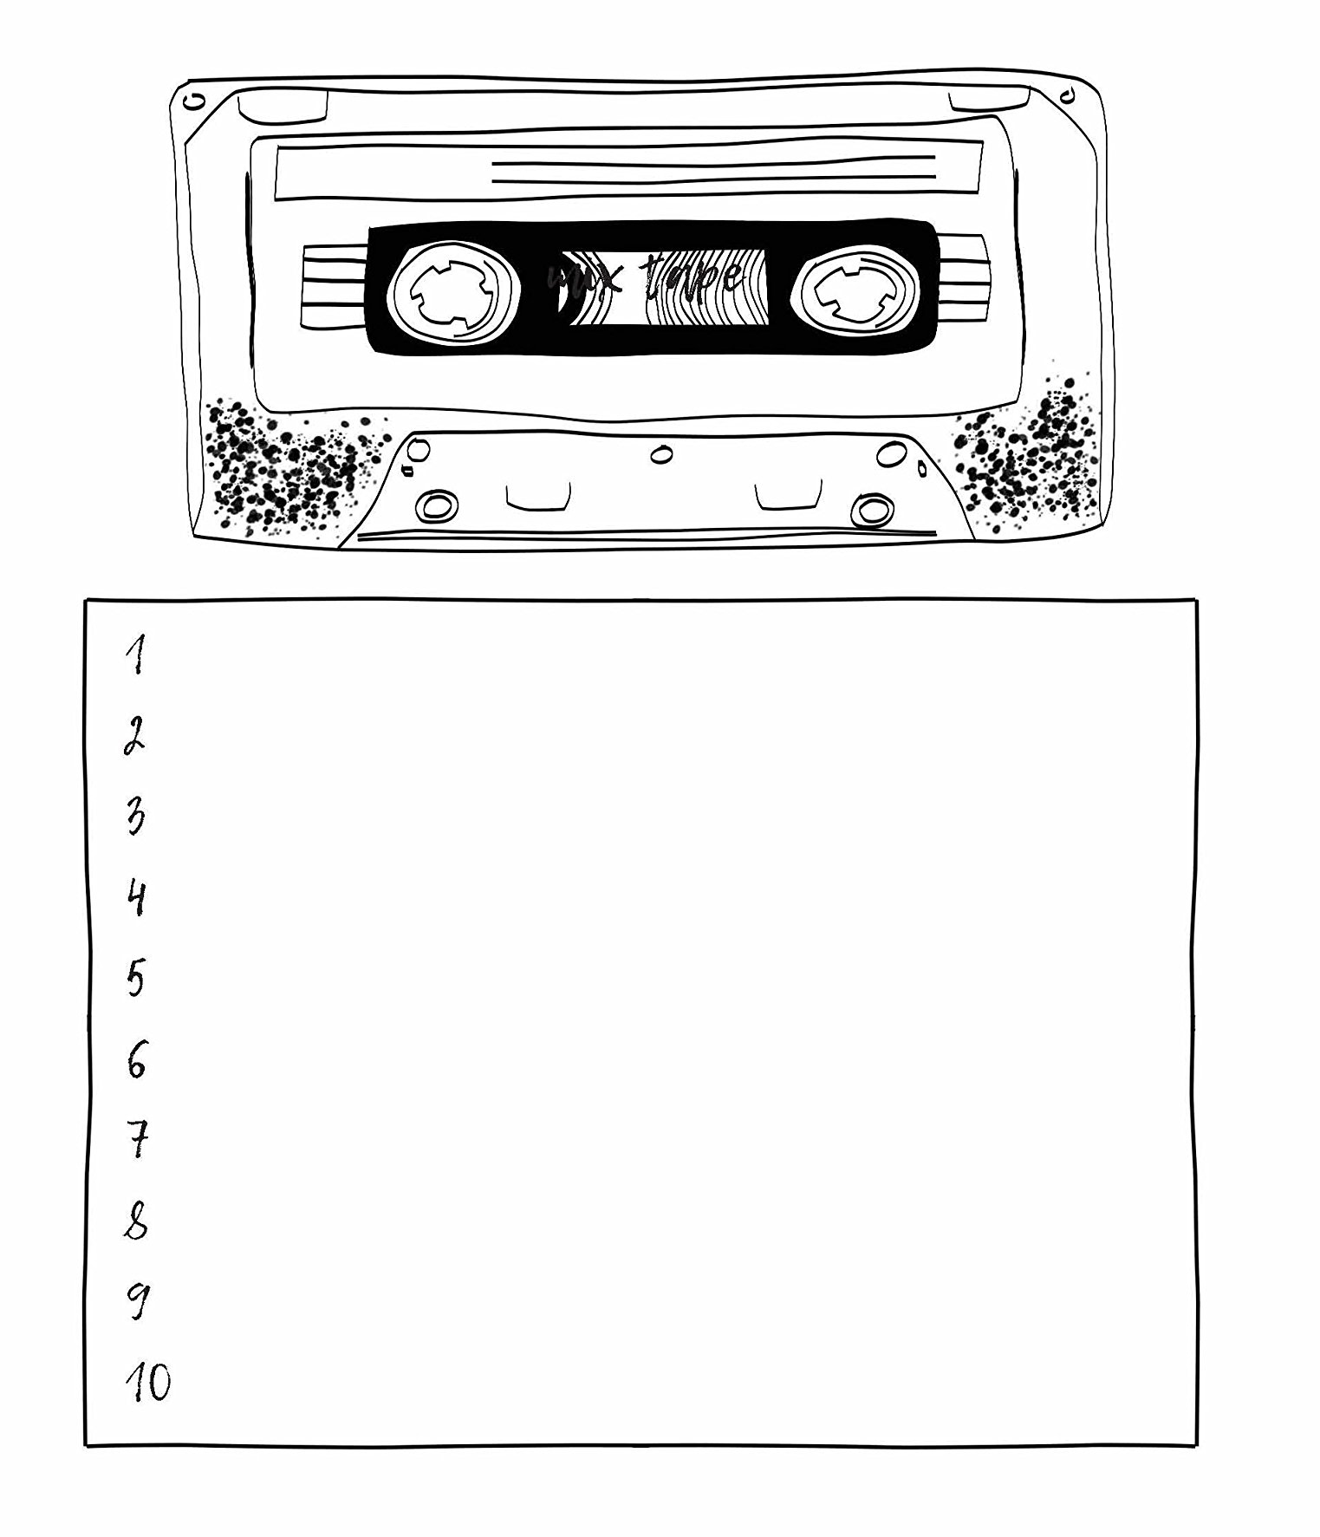
Make a specific playlist of songs to boost your mood.

Slide 7
“If everyone started off the day singing, just think how happy they’d be.”
– Lauren Myracle, Shine

Slide 8
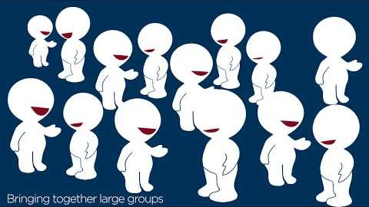
The Psychology of Singing
https://www.youtube.com/watch?v=oseoK9PopxQ

Slide 9
Benefits of Singing
Natural pain killer
Tension release
Calms negative mental 'chatter’ by distracting unhelpful thoughts.
Improved posture
Improved heart and lung health
Increase self-confidence
Look younger
Social bonding

Slide 10
