Slide 1

Group
Dynamics

Slide 2
“We cannot live for ourselves alone. Our lives are connected by a thousand invisible threads.”
(Herman Melville)

Slide 3
Group Dynamics - defined
Group dynamics is the study of groups, and a general term for group processes.
Group process refers to the understanding of the behaviour of people in groups.
When dynamics are positive, the group works well together. When dynamics are poor, the group’s effectiveness is reduced. Problems can come from poor facilitation, too much deference to authority, blocking, groupthink and free riding, among others.

Slide 4
Benefits of being in a group
The most popular reasons for joining a group are related to our needs for security, esteem, affiliation, power, identity, huddling, and task functions.
Affiliation – fulfil social need/opportunity for interaction
Security – reduce the threat of “standing alone”
Goal achievement – what cannot be achieved individually often becomes possible
Self-esteem – provides feelings of self-worth

Slide 5
Thinking about groups
Consider the following questions:
Groups:
What types of different groups are there? E.g. formal, informal, interest etc.
What important groups can you identify?
How many groups do you consider yourself in at the moment?
Observations on groups themselves:
What do you notice about what happens in groups?
When you have had positive experiences in a group and less positive? What do you notice happens?
Observations on yourself in a group:
How do you experience being in a group?
What do you notice about yourself when you first come into a group?
Does this evolve over time?
Do you feel you have a natural role/position that you often occupy?

Slide 6
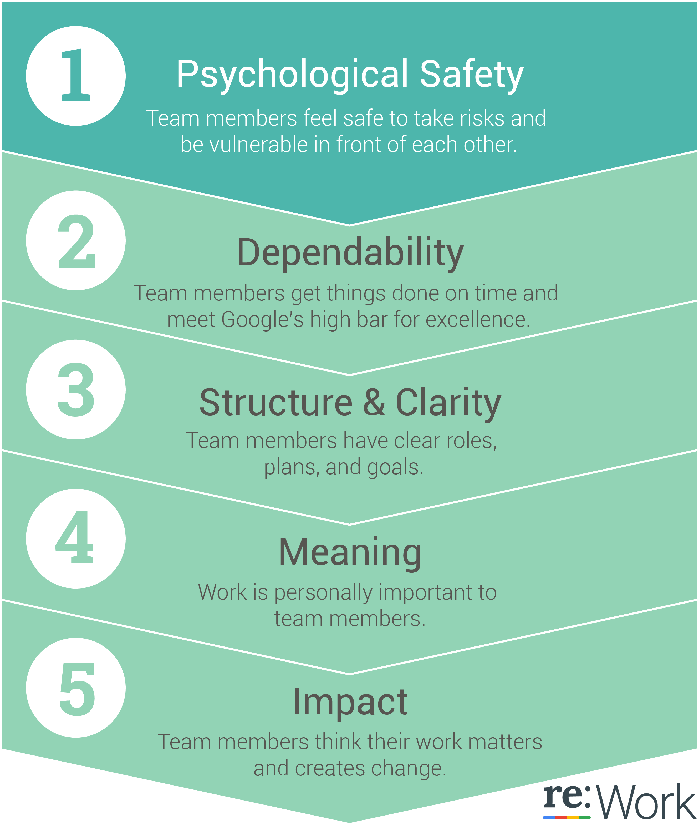
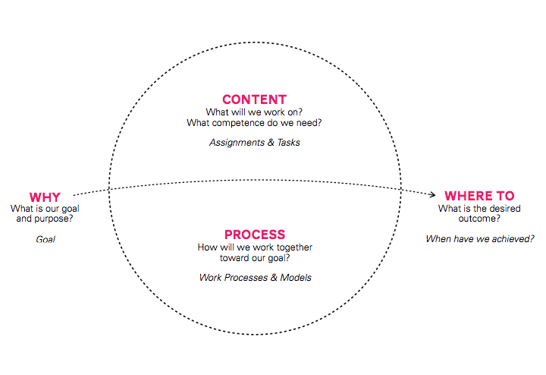
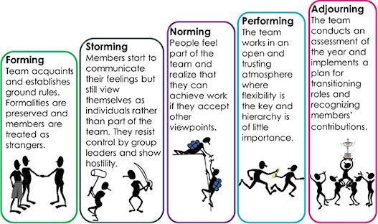

Slide 7
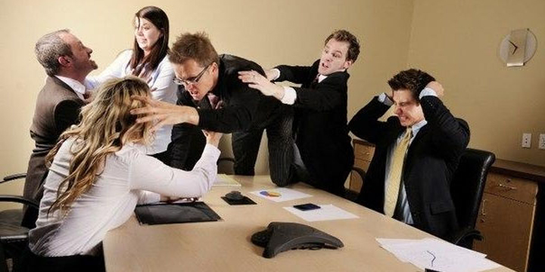
Group Dynamics
You probably know how frustrating it is when groups don’t work well.

Slide 8
Group issues
Social loafing: Individual energy expended goes down as the number of people goes up.
Group polarization: When in groups, views become extreme.
Group conflict: Conflict will inevitably arise in any group and the challenge for the group will be to resolve it creatively and effectively.
Groupthink: Isolated, biased and high stress can lead to unusual and closeminded decisions.

Slide 9
Group Process
Dorothy Stock Whittacker (1989) talks about the fact that each group will have a different character:
Groups develop particular moods and atmospheres.
Shared themes can build up in groups.
Groups evolve norms and belief systems.
Groups vary in cohesiveness and the permeability of their boundaries.
Groups develop and change their character over a period of time.
People occupy different positions in groups with respect to power, centrality and being liked or disliked.
Individuals sometimes find one or two other people in the group who are especially important to them because they are similar in some respect to significant others in their life or to significant aspects of themselves.
Social comparison can take place in the group.
A group is an environment in which people can observe what others do and say and then observe what happens next.
A group is an environment in which people can receive feedback from others concerning their own behaviour or participation.
A group is an environment in which new behaviours can be tried out.
In a group, members may collide and collude.

Slide 10
Transactional Analysis Drivers
Understand the group process and your behaviour more:
‘Be perfect’ driver – I am ok if I get everything right
How important for you is it to get it right? Are you being really careful how you say things?
‘Please others’ driver – I am only ok when I please others
Do you believe you have to behave in a certain way to please others? It is likely that if you are doing this in a group, it is a common trait in everyday life.
‘Hurry up’ driver – I am ok if I am busy and quick about it
Have you noticed that you are thinking I could be doing someone more useful if I wasn’t here? Are you finding it a waste of time? Are you finding it difficult to just sit and be and want to be doing?
‘Be strong’ driver – I am ok if I hide my feelings and needs from others, I must not be weak
Can you allow yourself to be upset and affected by other people? How easy is it for you to share your vulnerabilities in a group?
‘Try hard’ driver – I am only ok if I keep trying to do things
Students with this driver may say ‘I am trying to understand what this group is about, but I still don’t get it, I need to build my confidence up before I contribute anything.’

Slide 11
Role negotiation (Roger Harrison)
For each person, write a one word or short phrase to describe what you want more of and less of from them, and what you want maintained.
NAME | MORE | LESS | KEPT THE SAME

Slide 12
