Slide 1
Flow

Slide 2
“Being completely involved in an activity for its own sake. The ego falls away. Time flies. Every action, movement, and thought follows inevitably from the previous one, like playing jazz. Your whole being is involved, and you're using your skills to the utmost.”
(Mihaly Csikszentmihalyi)

Slide 3
Flow - defined
an optimal psychological state (Csikszentmihalyi)
a state of total focus on the task at hand; being in the present moment
associated with positive experiences and performance outcomes

Slide 4
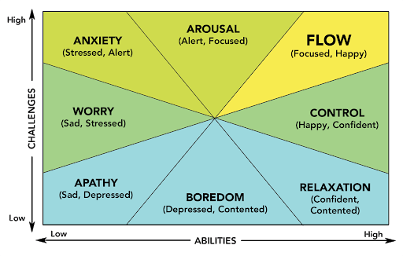
The Psychology of Flow

Slide 5
Zen Buddhism
Before enlightenment, chop wood, carry wood. After enlightenment, chop wood, carry wood.
If you walk, just walk. If you sit, just sit; but whatever you do, don’t wobble.
When hungry, eat your rice; when tired, close your eyes. Fools may laugh at me, but wise men will know what I mean.

Slide 6
Components of Flow
Challenge-Skill Balance.
A balance between the demands of the situation and personal skills.
Action-Awareness Merging.
Deep involvement that makes actions seem automatic.
Clear Goals.
Certainty about what one is going to do.
Unambiguous Feedback.
Immediate and clear feedback that reaffirms actions.
Concentration on Task at Hand.
Feeling focused.
Sense of Control.
Happens without conscious effort.
Loss of Self-Consciousness.
Concern for self disappears as person becomes one with activity.
Transformation of Time.
Time passes faster, slower, or there is unawareness of time.
Autotelic Experience.
Feeling of doing something for its own sake, with no expectation of future reward.
Notes:
9 components
#8 as least salient
#9 as most salient

Slide 7
“Flow is quite simply when you’ve managed to totally get out of your own way.”
(Floyd Woodrow)

Slide 8
Flow
Consider the following questions:
List your most common activities. Plot them on the flow state graph (see slide 3).
When are you in a state of flow? Can you think of any activities during which time disappears, you are completed absorbed into what you are doing?

Slide 9
A mindset that facilitates flow
Identify what is important – clear unambiguous goals
Move in the direction of what is important, taking into account feedback along the way
Embrace challenge
Stay in the present moment

Slide 10
Finding flow
Pick an activity that you can see yourself enjoying Ask yourself:
I value Flow most because it…
Inspires me to solve challenges creatively;
Lets me feel like I’m at one with everything that’s happening;
Is about the only time I can turn off my ‘to-do’ list;
Lets me share amazing moments with others.
I find myself in Flow most often…
Alone or with a tight crew who can keep up;
With people so we can build off each other’s energy;
When I’m by myself so I can focus deeply;
In serene settings where I feel connected to something bigger than myself.
I find Flow when…
My heart’s beating, adrenaline’s pumping and it’s make or break time;
We’re all swept up in the moment together and feel connected to something bigger than ourselves;
Everything’s beautiful and effortless - things happen perfectly;
Hours go by and I lose myself in my work and come up with something amazing.

Slide 11
Popular flow physical activities
Yoga – controlled breathing and a quiet setting are great conditions for focusing your thoughts on what you’re doing in the present, here and now. With the right challenge to skills ratio in terms of balance and stretching, some find yoga is very conducive to attaining a flow state.
Swimming – if you’re one who enjoys slightly more intense physical activities, swimming lets you concentrate on your technique, breathing. Plus, there are few distractions when you’re physically in the water.
Running – challenge levels are very straightforward to set when you’re running, allowing you to find the ideal balance with your abilities for attaining a flow state. If you find that you sometimes tend to ‘self-talk’ while running, or think things over, it may help to listen to music or a good audiobook.
Rock climbing – this activity featured quite frequently in Csikszentmihalyi and others’ earlier research, thanks to its ability to provide a flexible blend of physical exertion and focus.

Slide 12
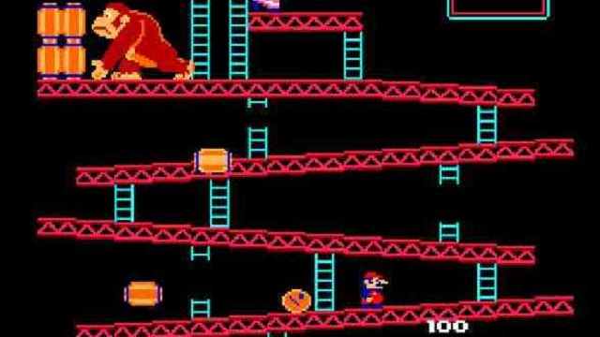
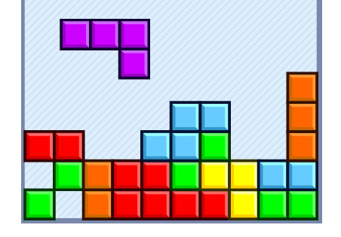
Computer game design & flow
A challenging computer game can make us feel overwhelmed, and more likely to give up. Similarly, a computer game that is too easy can induce boredom. To trigger flow, a good computer game should be halfway between these two extremes.
Levels
Points
Time limit
Prizes
Notes:
Levels
Points
Time limit
Prizes

Slide 13
