Slide 1
Visualisation

Slide 2
If you were to visualise yourself doing, being or achieving one thing in your life right now, what would it be? Would it be more confidence? More self-belief? A more fulfilling job or your ideal partner perhaps?
Notes:
The concept of transition is defined by some as the psychological process that an individual goes through to come to terms with a new situation. Life transitions occur as a result of planned or unplanned events and changes that occur in your everyday life. Each transition has its own unique set of challenges.

Slide 3
Visualisation
The word imagination comes from the Latin word imaginare which means to form an image, or to represent. It is one of the most important, creative aspects of the human mind. When you use your imagination, you are giving the subconscious a canvas on which to paint your desired self-image.
Einstein once said, “Imagination is more powerful than knowledge.” It is what allows you to see and shape any scenario that you wish to make real. If you don’t like your reality, you must change your mental images. By changing your mental images, you change your reality.

Slide 4
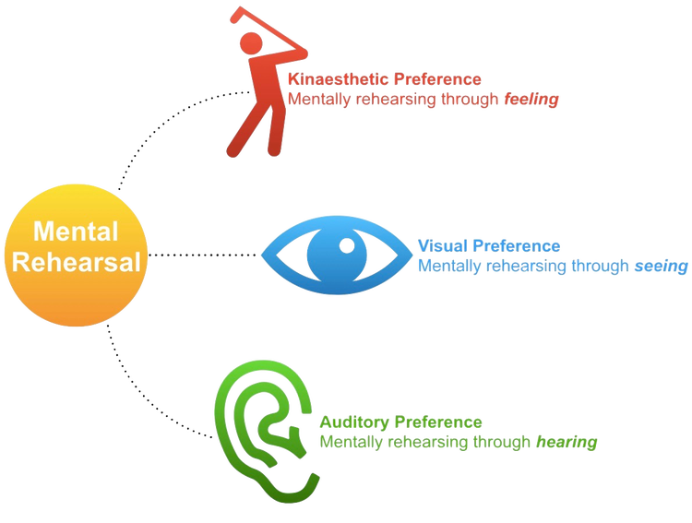
Mental Rehearsal

Slide 5
A Mental Rehearsal Procedure
Find a time and place where you won't be interrupted.
Recline or lie down and close your eyes.
Relax, concentrate, and focus. Take deep breaths and exhale slowly. As you exhale, imagine that stress is leaving your body. Start at your feet ... feel all the stress leave your feet ... then your legs ... then your chest ... all the way to the top of your head ... feel all the stress leave your body. Free your mind of distractions and allow your mind to focus on the relaxation process.
Once relaxed, focus on the specific challenging task.
Mentally tell yourself that you are confident and that you have the ability to perform this task successfully. Repeatedly tell yourself, with confidence, that you will be successful.
Imagine what you will see just before you begin the task. Visualise yourself as an active participant, not as a passive observer. For example, to mentally rehearse putting a golf ball, imagine that you are standing on the green rather than watching yourself from the gallery.
Remaining relaxed and focused, mentally rehearse successful performance of this task. Imagine going through the process and seeing successful results.
Repeat step 7 several times.
Finally, open your eyes and smile. You have successfully performed in your mind, which is great preparation for actual performance. You should now be confident that you will perform successfully in the real situation. Remember to praise yourself for being successful. Self-reinforcement is another a key to self-motivation.

Slide 6
Solution-Focused Morning plan
Create your day in advance by thinking about the way you want it to go, and you will create your life intentionally.
Sit down and take 10, very slow, very deep breaths. Take 10 more breaths only this time incorporating the suggestion, calm and relaxed, while you breathe with positive suggestion.
Imagine how you want the day to unfold using process imagery. Visualise your desired intentions, exactly the way you want them to look in reality.
See yourself in your mind’s eye at different times throughout the day (10am, 12pm, 3pm and 5pm and so on) and keep these images positive and intentional.
Imagine what you are going to be doing at the end of the day (result imagery) and how you are going to look and feel.
Intention counts!

Slide 7
Imagination creates the potential for success by showing the mind your truest intentions.
Imagination helps you view many possibilities without relying on one logical answer. Imagination has the power to create any sensation felt or about to be felt.
Creative or active visualization is the ability to productively use your imagination.
It is how you turn images into reality.
The more feeling emotion you attach to an image, the quicker it manifests into reality.
Images with emotion have potent energy, especially when you involve your senses. Imagination attracts that which you desire.
The opportunities present themselves.
Imagination has unlimited power, providing of course you don’t limit your imagination.
If you keep imagining the same thing, and keep thinking the same thoughts, other people unconsciously act upon your thoughts.
Thoughts and powerful imaginings have the ability to travel from one mind to another.
This bolsters your position for attracting success, for others are now also working on your behalf.

Slide 8
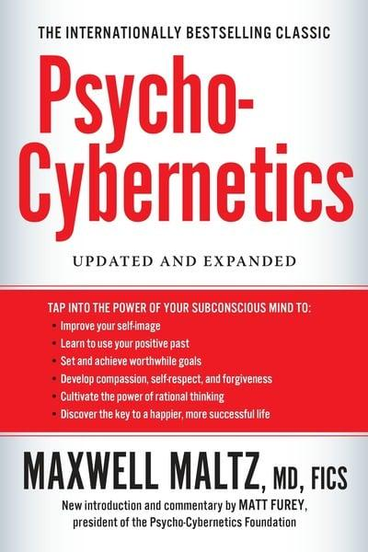
Psycho-Cybernetics
Dr. Maxwell Maltz (1889-1975)
Psycho - Cybernetics
We have two images:
Mirror reflection
The image we hold in our mind (self-image)
The way that you see yourself is the way that you live your life.
You can’t grow beyond your self-image without your self-image without changing your self-image first.

Slide 9
Instilling a positive self-image
Success from the inside out!
Build a mental picture of who you want to be, the life you want to live. Bring the image to life with your five senses. For example, what would you look like if you were at your natural best. How would you walk, talk and behave? Visualise your mannerisms and your body language. Add emotions. Repeat.

Slide 10
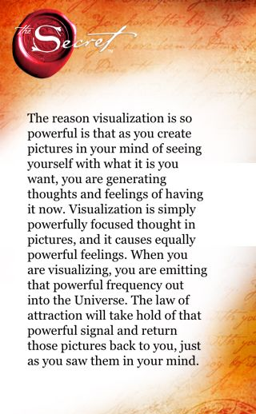
The Law of Attraction
The mind is a powerful tool. What you focus on is what you get.
The Law of Attraction says like attracts like, so when you think a thought, you are also attracting like thoughts to you.
Ask, Believe, Receive
Ask the universe for what you want.
Believing involves acting, speaking and thinking as though you have already received it.
Receiving involves feeling the way you will feel once your desire has manifested.

Slide 11
Self-Talk
Understanding the significance of your words
When you make a statement containing the words don’t, not or no, you are actually giving attention and energy to what you don’t want.
Simply ask yourself
“SO, WHAT DO I WANT?”

Slide 12
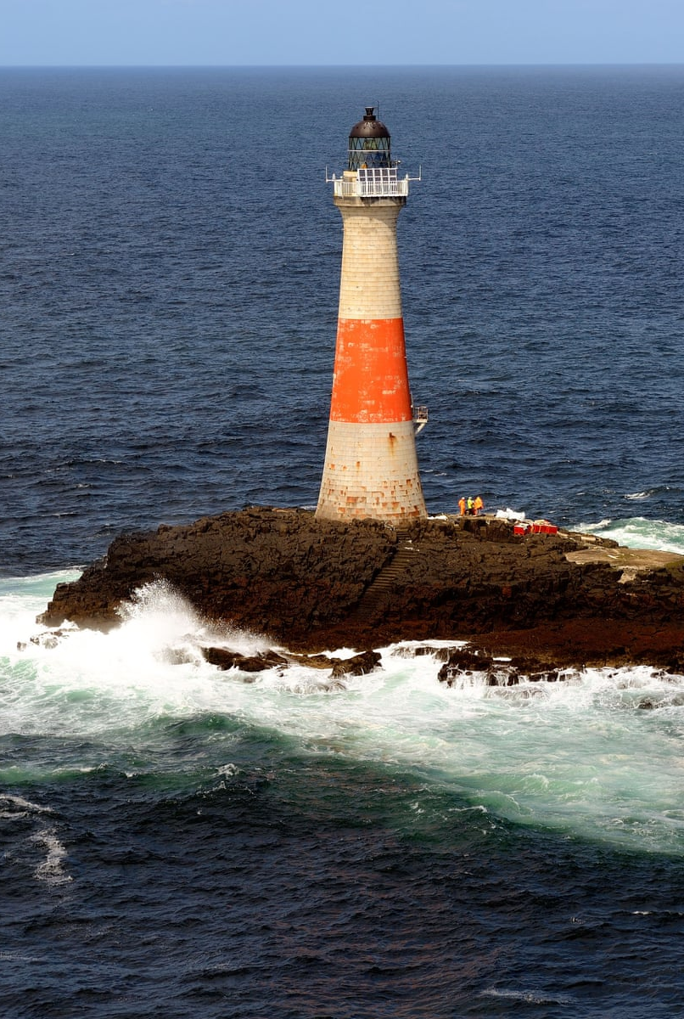
Lighthouse imagery
Visualise a small rocky island off the coast. On the highest spot of the island is a tall, solidly constructed lighthouse. Imagine yourself as that lighthouse, with your base firmly anchored in the rock of the island. Your walls are thick and sturdy so that, despite your height, you do not bend or sway in the high winds that frequently blow across the island.
From the window in your top, you send out a steady sweep of light, by day and by night, in good weather and bad. Be aware of all the power you have that ensure the constancy of your light beam sweeping its circular path across the ocean, warning the ships of the shoals, offering a symbol of security to the people on the shore.
Now feel the centre of inner light within you, that light that can never be extinguished.

Slide 13
Run Your Own Movie
Imagine sitting in a movie theatre, the lights dim, and then the movie starts. It is a movie of you doing perfectly whatever it is that you want to do better. See as much detail as you can create, including your clothing, the expression on your face, small body movements, the environment and any other people that might be around. Add in any sounds you would be hearing - traffic, music, other people talking, cheering. And finally, recreate in your body any feelings you think you would be experiencing as you engage in this activity.
Get out of your chair, walk up to the screen, open a door in the screen and enter into the movie. Now experience the whole thing again from inside of yourself, looking out through your eyes. This is called an “embodied image” rather than a “distant image.” It will deepen the impact of the experience. Again, see everything in vivid detail, hear the sounds you would hear, and feel the feelings you would feel.
Repeat daily. Manifest it in your life.

Slide 14
Activity: Best Possible Self
Visualise your best possible future self. Select a time in the future - it could be six months, two years or ten years from now from now. Imagine yourself in that future where things have gone right.
Now spend 10 minutes writing a description of that future self. How would you feel? Where would you be? Who would you be with?
Do this exercise for at least three days in a row. Each day, reflect on this desired future, and then discover ways to make it become a reality!

Slide 15
