Slide 1
Accountability

Slide 2
Personal Accountability - defined
Personal accountability is being willing to answer for the outcomes resulting from your choices, behaviours, and actions.
When you're personally accountable, you take ownership of situations that you're involved in. You see them through, and you take responsibility for what happens – good or bad.
Accountability also builds trust because people know they can depend on you.

Slide 3
Personal Accountability

Slide 4
Personal Accountability
Describe how you take personal responsibility for your own life.
Consider the following questions:
How do you keep a track of your life?
How do you ensure you are working towards creating a life you want?
How do you measure your progress towards your goals?
Do you have people around you to support you towards your goals? If so, how do you create accountability in those relationships?

Slide 5
Accountability continuum
Where do you stand?
Victim
Accountable
Blame others
Make excuses
Wait. Hope it will get better
Acknowledge reality
“Own it”. Take responsibility.
Find solutions.

Slide 6
There was an important job to be done and Everybody was asked to do it. Everybody was sure Somebody would do it. Anybody could have done it, but Nobody did it. Somebody got angry about that, because it was Everybody’s job. Everybody thought Anybody could do it but Nobody realized that Everybody wouldn’t do it. It ended up that Everybody blamed Somebody when Nobody did what Anybody could have done.

Slide 7
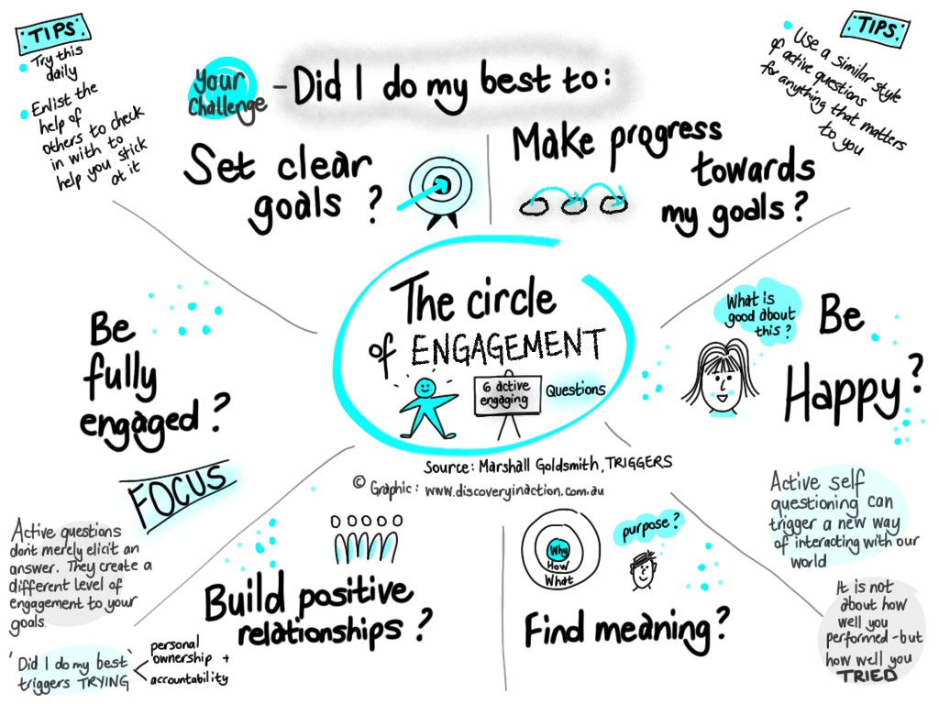

Slide 8
Daily Questions – Marshall Goldsmith
Develop a report card
Active questions
Focus on effort
Enlist a friend
Did I do my best today to:
1. Be happy? (1-10)
2. Find meaning? (1-10)
3. Build positive relationships? (1-10)
4. Be fully engaged? (1-10)
5. Set clear goal? (1-10)
6. Make progress toward my goals? (1-10)
Self-monitoring is the ability to both observe and evaluate one's behaviour.

Slide 9
DAILY QUESTIONS
 | Days |  |  |  |  |  |  | Total
Did I do my best today to: (1-10 score) | 1 | 2 | 3 | 4 | 5 | 6 | 7
Remember:
Change doesn’t happen overnight.
It is not about how well you performed but how well you tried.
Success is the sum of small efforts repeated day in and day out.

Slide 10
